Slide 1
Library preparation
Please revise slides 2-8 before the workshop

Slide 2
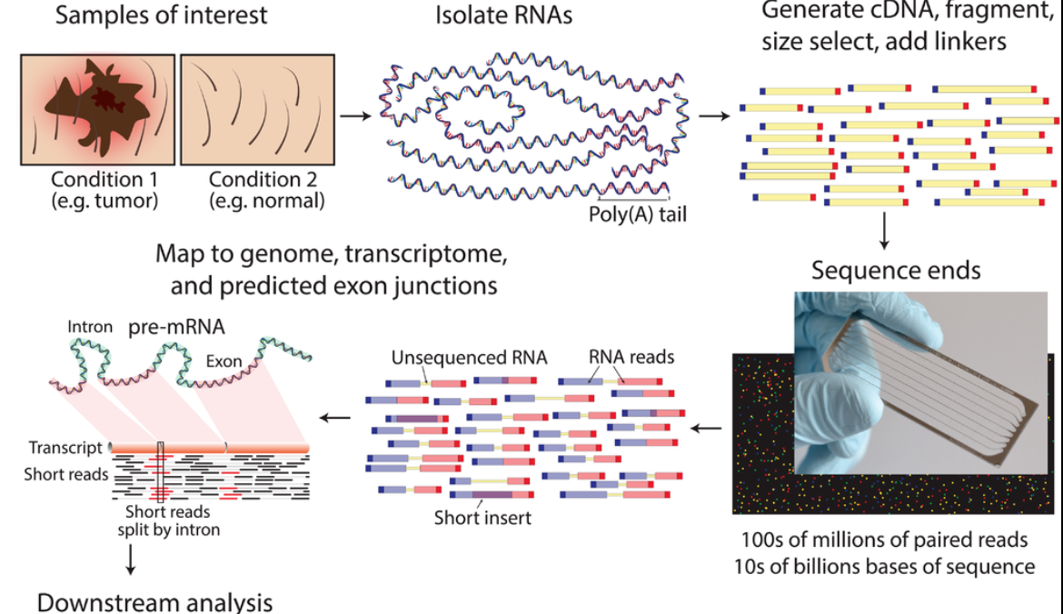
RNA-seq - experiment
mean length of 300 bp (typically ranging 200–700 bp
https://www.wikiwand.com/en/RNA-Seq

Slide 3
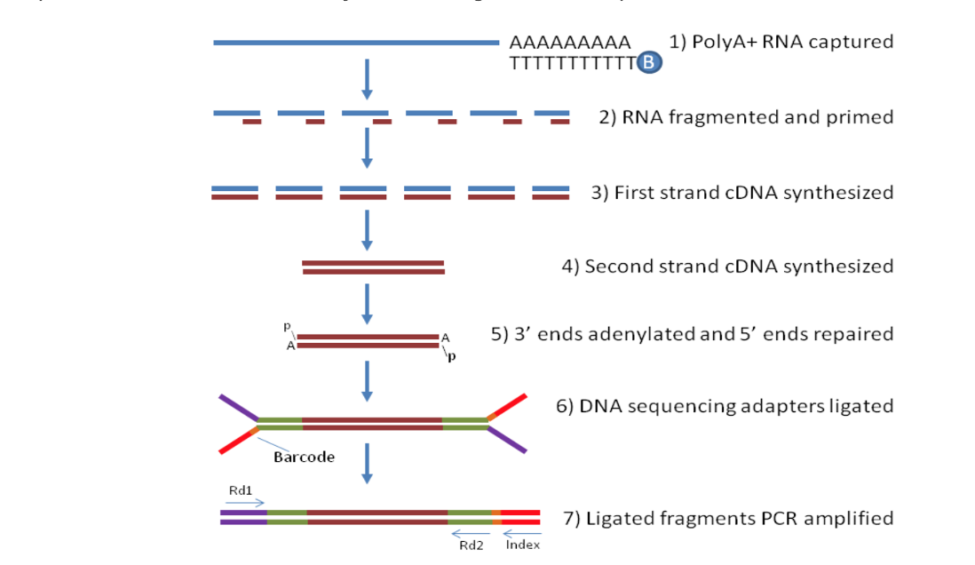
How does the bulk-RNA-seq technology work?
Notes:
From http://rockefelleruniversity.github.io/RU_RNAseq/
More details here: https://rnaseq.uoregon.edu/#rna-prep-overview

Slide 4
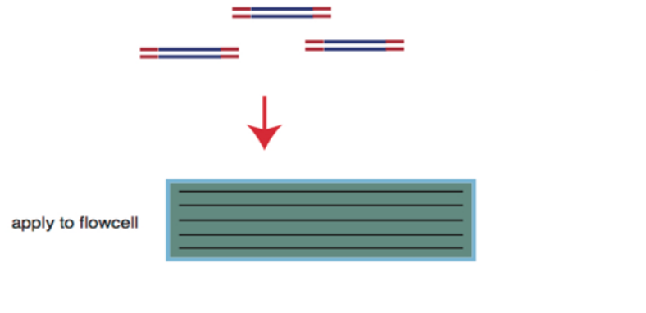
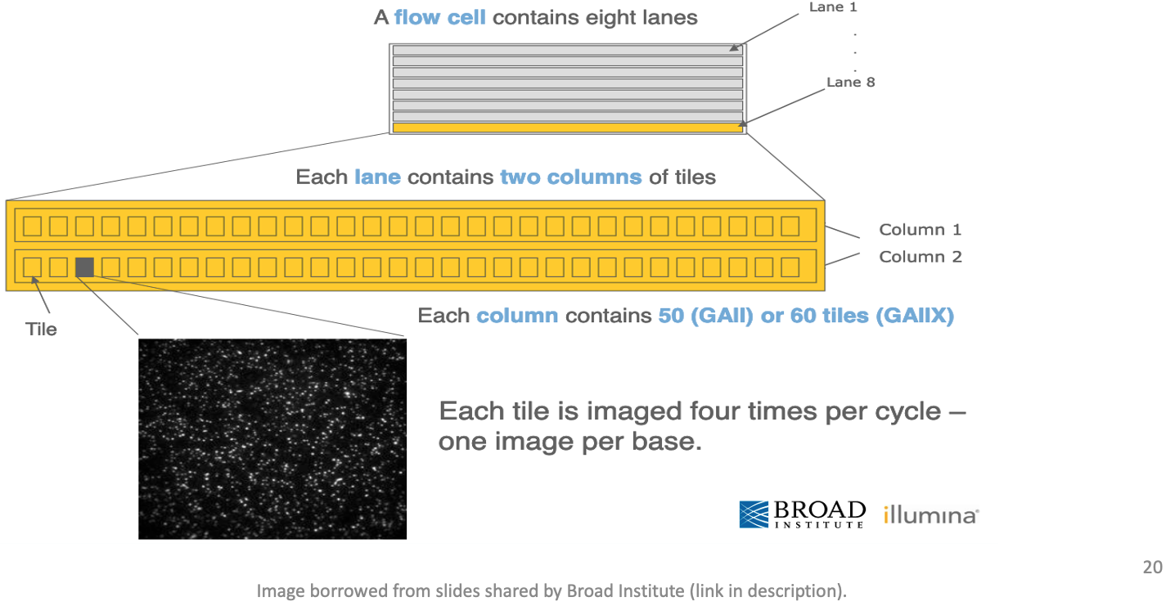
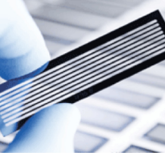
Flow cell organization for sequencing
cDNA library is applied to a flow cell
Notes:
From https://www.broadinstitute.org/files/shared/illuminavids/sequencingSlides.pdf

Slide 5
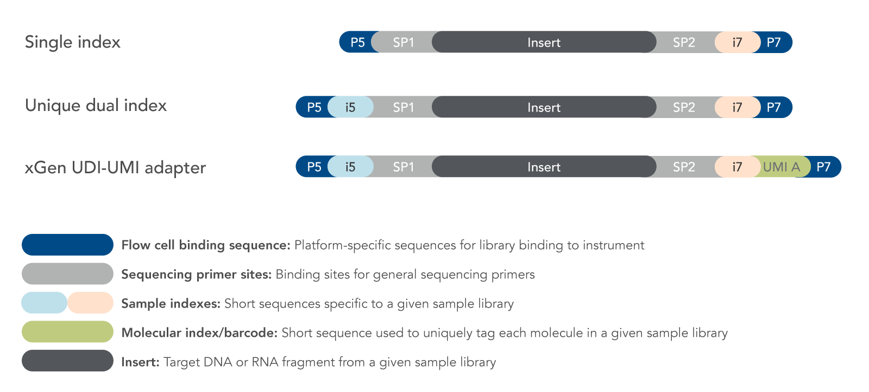
Fragments preparation for the sequencer
Notes:
From http://rockefelleruniversity.github.io/RU_RNAseq/
More details here: https://rnaseq.uoregon.edu/#rna-prep-working-with-rna

Slide 6
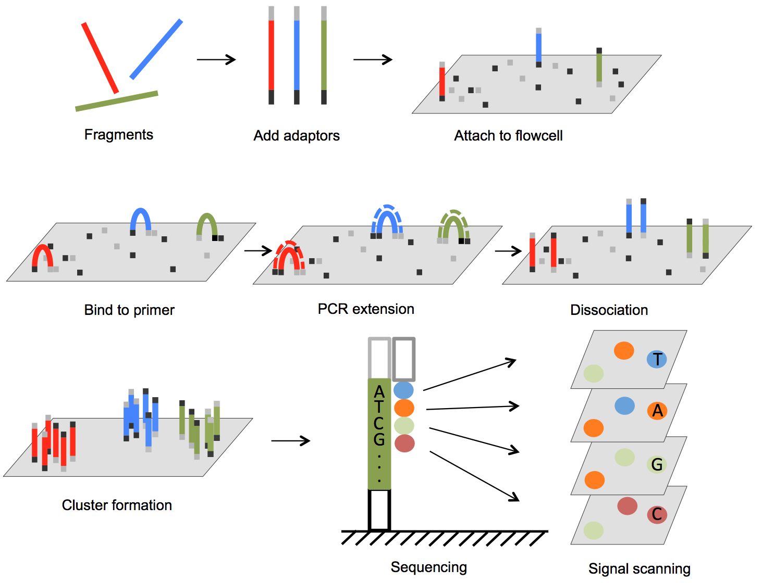
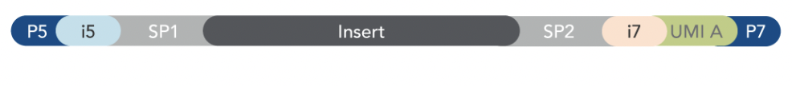

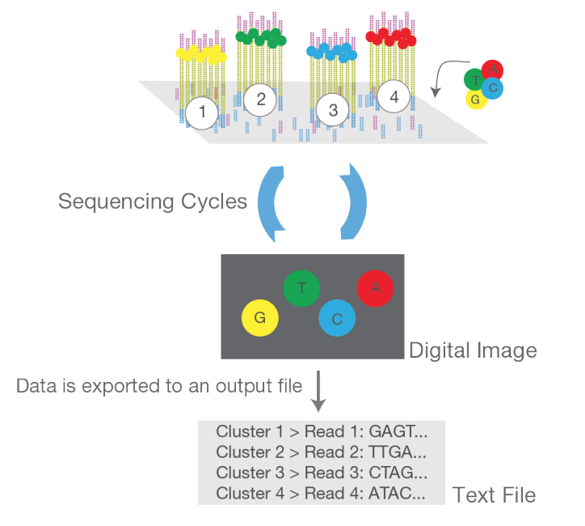

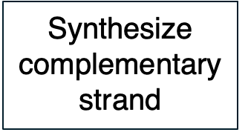

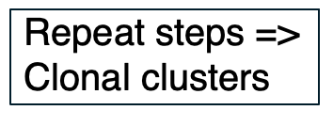
DNA fragments immobilized on flow cell & amplified into clonal clusters
ds cDNA > ss cDNA
From DOI: 10.5772/61657 and https://www.illumina.com/content/dam/illumina-marketing/documents/products/illumina_sequencing_introduction.pdf
Notes:
Cluster amplification: https://youtu.be/3URxJD5k3T8

Slide 7
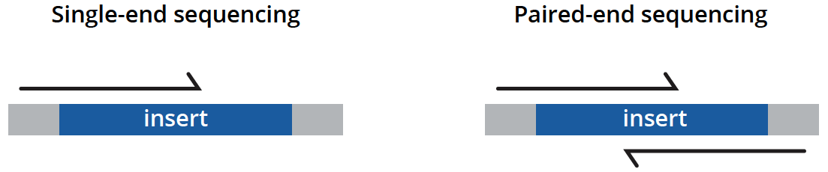
Types of sequencing
unidirectionally - sequencing from one end only
less expensive, is typically reserved for quantifying gene expression in well-annotated genomes and analyzing small RNA molecules.
bidirectionally - both ends of DNA fragments to be sequenced
usually recommended for most applications as it provides richer data and permits longer library insert sizes.
https://www.genewiz.com/
Notes:
Suggesting reading https://bmcbioinformatics.biomedcentral.com/articles/10.1186/s12859-020-3484-z

Slide 8
Library preparation affects the downstream analysis
RNA quality is fundamental
RNA extraction method can affect the transcript abundance
Choice of platform and library preparation protocol

Slide 9


Slide 10
Working material for this workshop
Single_read.fastq
Bacteria_GATTACA_L001_R1_001.fastq
Adapter_Sequence.fasta
rDNA_sequence.fasta
rDNA.gtf
all_steps_docker_desktop_mac.sh
all_steps_docker_desktop_windows.sh
Slides
Please install Docker https://docs.docker.com/get-docker/

Slide 11
Introduction to RNA-seq data analysis
Michela Traglia, Ayushi Agrawal
Bioinformatics Core, GIDB
September 22-23, 2025

Slide 12
Introductions
Michela Traglia
Senior Statistician
Ayushi Agrawal
Bioinformatician III

Slide 13
Workshop sessions
Session I
Monday - September 22
1-3 pm
Session II
Tuesday - September 23
1-3 pm
DEG analysis - Intermediate workshop
Monday - October 06
1-4 pm

Slide 14
Poll 1
Which is your expectation from this workshop?
I want to:
1) Analyze my RNA-seq raw data
2) Improve my existing analysis pipeline settings
3) Learn about RNA-seq analysis
Please select all that apply.

Slide 15
Goals
By the end of this workshop you should be able to:
Demystify each step of the RNA-Seq data analysis
Understand the bioinformatic pipeline from raw data
Enable informed conversations with computational biologists
Demonstrate how to analyze data using docker
Not to provide end-to-end fits all analysis pipeline
Notes:
This slide deck gives an overview of the tools and tech underlying RNA-seq.
Docker (https://www.docker.com/) is a software platform that allows you to build, test, and deploy applications quickly. Docker packages software into standardized units called containers that have everything the software needs to run including libraries, system tools, code, and runtime. Using Docker, you can quickly deploy and scale applications into any environment and know your code will run.
What is an HPC? https://insidehpc.com/hpc-basic-training/what-is-hpc/

Slide 16
Target audience
Intended for beginners with no prior experience; it might feel slow if you are already familiar with the concepts.
Expected familiarity with command line
Designed for curiosity and continued exploration after the workshop!

Slide 17
Workshop outline
Session 1
RNA-seq experiments and protocols overview
Understanding the sequencer output
From sequencer output to FastQC
From FastaQC to Trimming
Mapping to reference genome
Break
Introduction to docker and setup
Session 2 (tomorrow)
Summarize steps so far
From alignment to counting features
Break
Demo
Additional resources

Slide 18
Session 1

Slide 19
RNA-seq - analysis workflow
Biological question
Library preparation
Sequencer: Reads Fastq
Quality check
FastQC
Session 1 Concepts:
Trimming
cutadapt
Quality check
FastQC
Session 2 Demo
Alignment/Mapping
STAR
Quality check
Session 2 Concepts:
Counting Reads
featureCounts
Quality check
DGE brief overview
Intermediate RNA-seq using R workshop
May 19, 2025 1-4p
Notes:
Sequencing centers often provide reads in the FASTQ format. The raw reads contain sequences of adapters added during library preparation, which are trimmed to start with. Then, the reads are typically mapped to a reference genome sequence. Counts of reads mapping to genes are tallied and used for differential gene expression analysis. At all stages, it is important to perform quality control of the data. All the tools mentioned in the subsequent slides for these steps are available via docker or can be installed locally.
Please download and install Docker Desktop from: https://docs.docker.com/get-docker/
All UCSF/Gladstone affiliates can request access to Wynton. Visit https://wynton.ucsf.edu/hpc/about/join.html

Slide 20

Bulk RNA-Seq
Advantages and limitations
Averaged gene expression from a population of cells
● A major breakthrough (replaced microarrays) in the late 00’s and has been widely used since
● Useful for comparative transcriptomics, e.g. samples of the same tissue from different species
● Useful for quantifying expression signatures from ensembles, e.g. in disease studies
● Insufficient for studying heterogeneous systems, e.g. early development studies, complex tissues
● Does not provide insights into the stochastic nature of gene expression (fluctuations in mRNA)

Slide 21
Bulk RNA-Seq
Averaged gene expression from a population of cells
Applications
Qualitative: identifying (annotating) or refining expressed transcripts, exon/intron boundaries, transcriptional start sites (TSS), and poly-A sites.
Quantitative: measuring differences in expression, alternative splicing, alternative TSS, and alternative polyadenylation between two or more treatments or groups. (i.e. experiment to measure differential gene expression - DGE)
Notes:
annotate novel transcriptional events, e.g., exon skipping, alternative 3’ acceptor or 5’ donor sites, intron retention

Slide 22
Experimental design is fundamental
Which biological questions we want to answer
Coding or non coding RNA?
Why do you expect to find differentially expressed genes in the particular tissue?
How many tissue types and/or time points to compare?
What types of genes do you expect to find differentially expressed?
What are the sources of variability from your samples?
More technical questions
Which sequencing platform?
Depth of sequencing?
Pooling samples?
Biological replicates/technical replicates?
Many others...

Slide 23
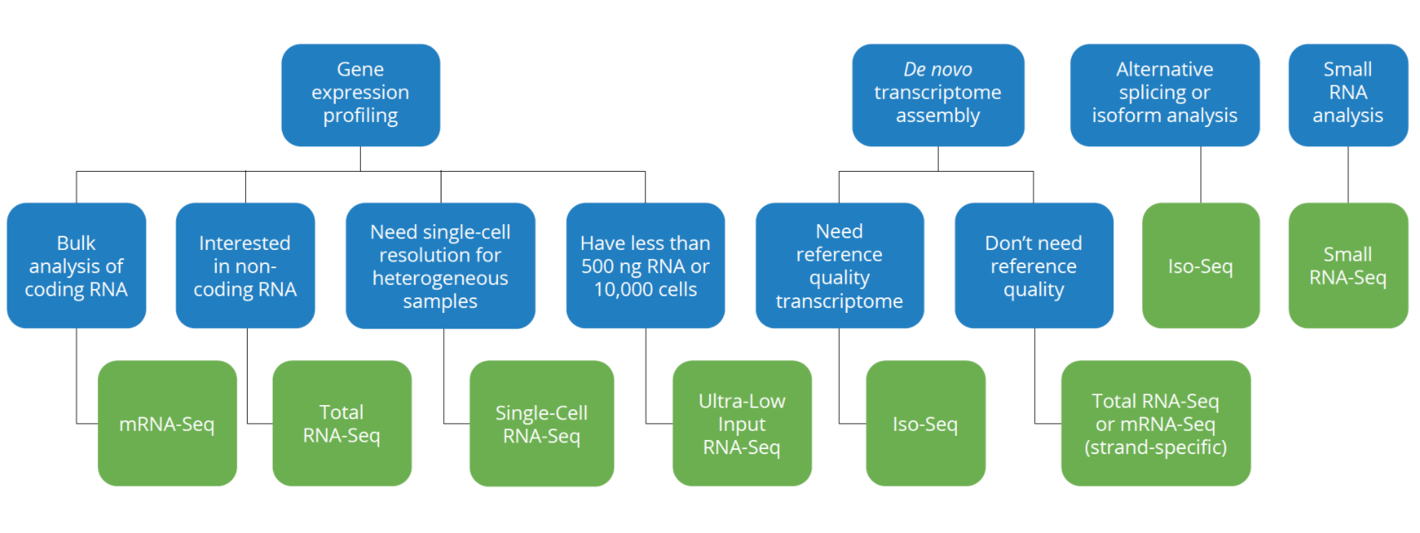
Which RNA-seq assay should I use?
From: Genewiz
Notes:
QuantSeq - https://www.nature.com/articles/nmeth.f.376

Slide 24
RNA-seq - experiment
mean length of 300 bp (typically ranging 200–700 bp)
https://www.wikiwand.com/en/RNA-Seq

Slide 25
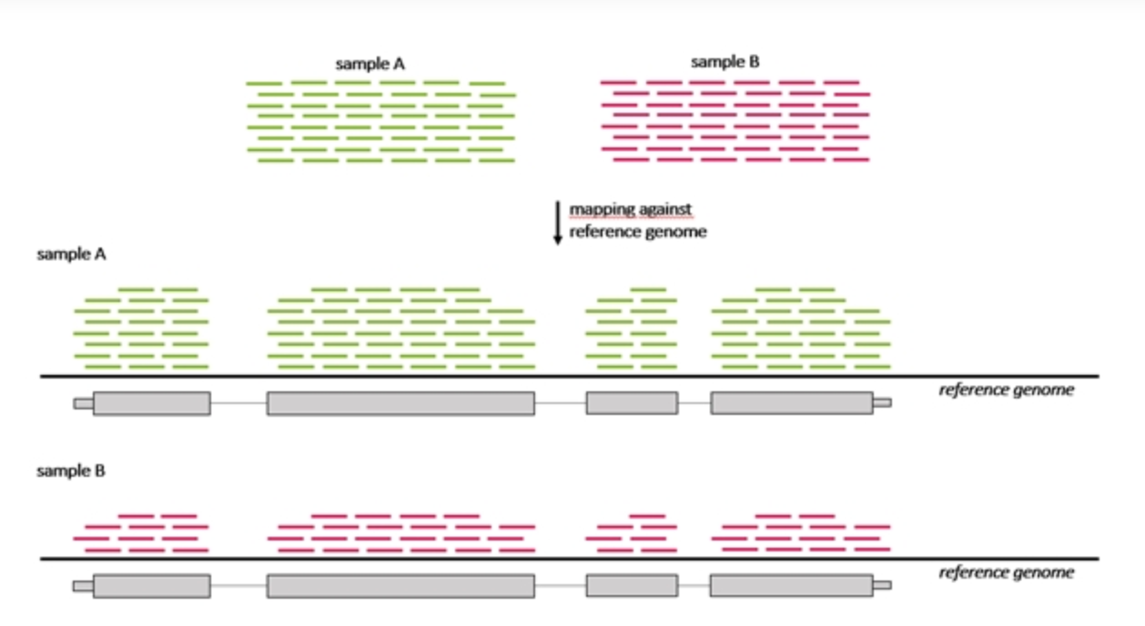
RNA-seq - differentially expressed genes (DGE)
Which genes are expressed at different levels between conditions (sample A and sample B)
Many steps to calculate the DGE between sample A and B
Source : seqme

Slide 26

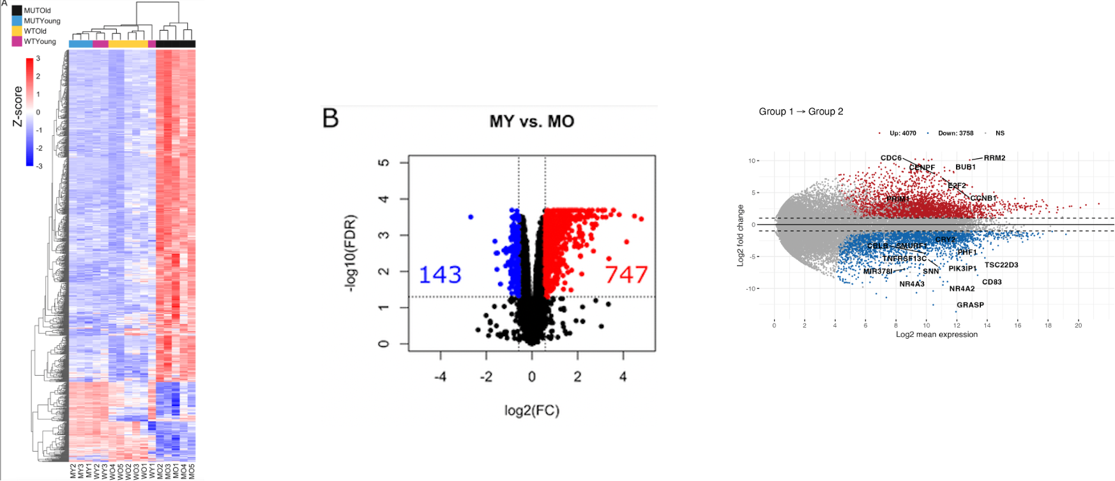
Goal of the DEG analysis - Intermediate workshop

Slide 27
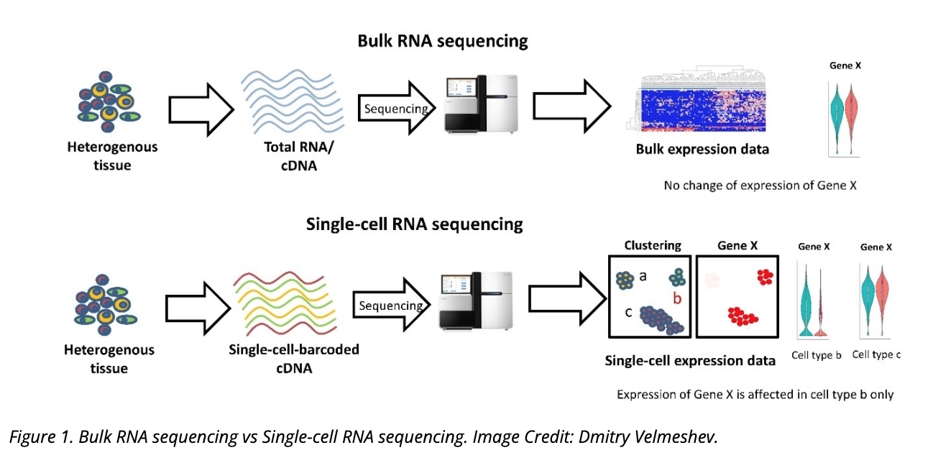
Bulk RNA-seq vs single cell (sc) RNA-seq
Measures the average expression level for each gene across a large population of input cells
From: https://www.technologynetworks.com/genomics/articles/recent-advances-in-single-cell-genomics-techniques-324695
Notes:
There is another new technology called spatial transcriptomics which is somewhere in the middle of RNA-seq and single-cell RNA-seq when it comes to cellular resolution.
https://www.genengnews.com/commentary/point-of-view/single-cell-explorations-are-underway-and-spatial-is-the-next-frontier/

Slide 28

RNA-seq - analysis workflow
Biological question
Library preparation
Sequencer: Reads Fastq
Quality check
FastQC
Session 1 Concepts:
Trimming
cutadapt
Quality check
FastQC
Demo
Alignment/Mapping
STAR
Quality check
Session 2 Concepts:
Counting Reads
featureCounts
Quality check
DGE brief overview
R
Notes:
Sequencing centers often provide reads in the FASTQ format. The raw reads contain sequences of adapters added during library preparation, which are trimmed to start with. Then, the reads are typically mapped to a reference genome sequence. Counts of reads mapping to genes are tallied and used for differential gene expression analysis. At all stages, it is important to perform quality control of the data. All the tools mentioned in the subsequent slides for these steps are available via docker or can be installed locally.
Please download and install Docker Desktop from: https://docs.docker.com/get-docker/
All UCSF/Gladstone affiliates can request access to Wynton. Visit https://wynton.ucsf.edu/hpc/about/join.html

Slide 29
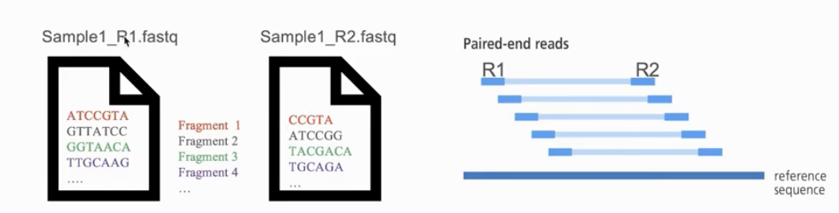
Naming conventions for fastq files
File names often follow a format.
SampleName_SampleNumber_LaneNumber_ReadNumber_SetNumber.fastq
Eg – Bacteria_S1_L001_R1_001.fastq
Paired-end reads named with R1 and R2 in file name.
Eg – Bacteria_GATTACA_L001_R1_001.fastq and Bacteria_GATTACA_L001_R2_001.fastq
File extensions may be .fq or even .txt
Often compressed using gzip.
gzip is free and open-source.
Resulting file names have .gz added. Example – .fq.gz.
Notes:
File names samplename_S1_L001_R1_001.fastq.gz
samplename—The sample name provided in the sample sheet. If a sample name is not provided, the file name includes the sample ID, which is a required field in the sample sheet and must be unique.
S1—The sample number based on the order that samples are listed in the sample sheet starting with 1. In this example, S1 indicates that this sample is the first sample listed in the sample sheet.
L001—The lane number.
R1—The read. In this example, R1 means Read 1. For a paired-end run, there is at least one file with R2 in the file name for Read 2.
001—The last segment is always 001

Slide 30
FASTQ files are text files with detailed information about each read.
@A00564:60:HHJKFDMXX:1:1101:2031:1031 1:N:0:TGGCTTCA+CAACCACA
CGGACTGGTGGTATGCTGAGTACGTCCCAAGGGTATGGCTGTTCGCCATA
+
;;>@:=;=::@B;>A=<<=B?;;=@@?<?=B;A@=B?>=B:=B=@<<B:;

Slide 31
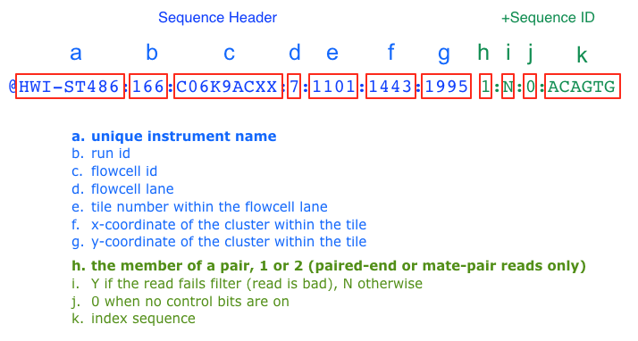
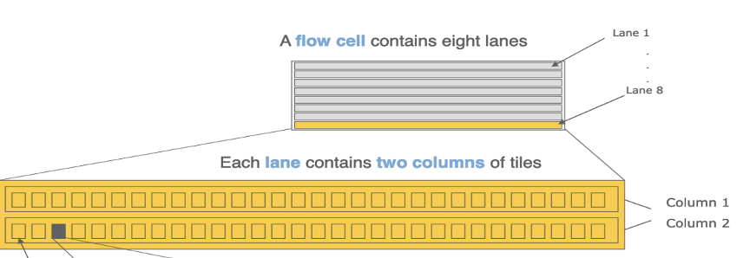
Label format in FastQ file
The more recent versions of Illumina software output a sample number (as taken from the sample sheet) in place of an index sequence (k).
Notes:
Suggested reading:
https://help.basespace.illumina.com/articles/descriptive/fastq-files/

Slide 32
Phred quality ccores
@A00564:60:HHJKFDMXX:1:1101:2031:1031 1:N:0:TGGCTTCA+CAACCACA
CGGACTGGTGGTATGCTGAGTACGTCCCAAGGGTATGGCTGTTCGCCATA
+
;;>@:=;=::@B;>A=<<=B?;;=@@?<?=B;A@=B?>=B:=B=@<<B:;

Slide 33
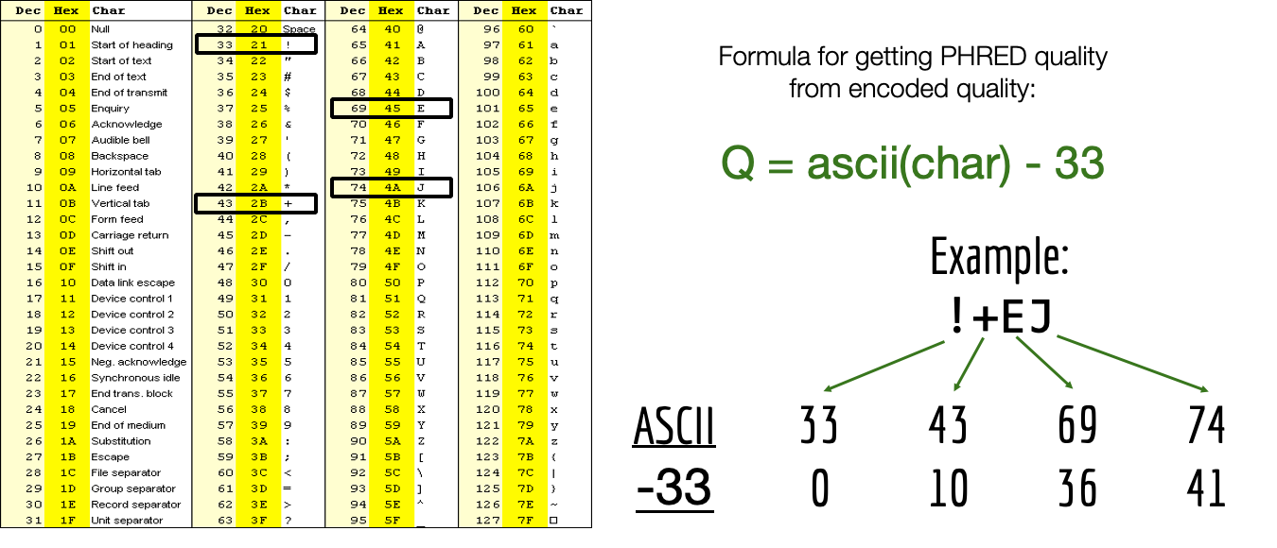
Quality score encoding based on ASCII table
Measurement of the likelihood that a base call in DNA sequencing is incorrect
Notes:
https://www.illumina.com/science/technology/next-generation-sequencing/plan-experiments/quality-scores.html
American Standard Code for Information Interchange

Slide 34
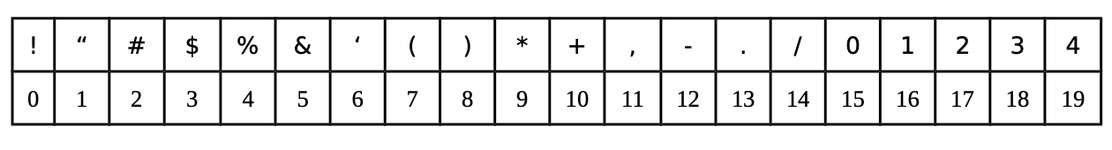
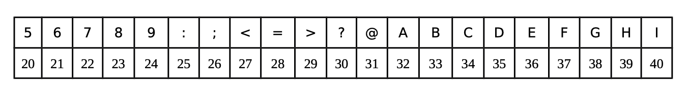
Phred quality score of each base
Each symbol is a probability p that the base call is incorrect.
The standard Sanger sequencing score to assess reliability of a base call is Q=−10 log10(p)
p, the probability that a given base is incorrectly called
Notes:
https://www.illumina.com/science/technology/next-generation-sequencing/plan-experiments/quality-scores.html

Slide 35
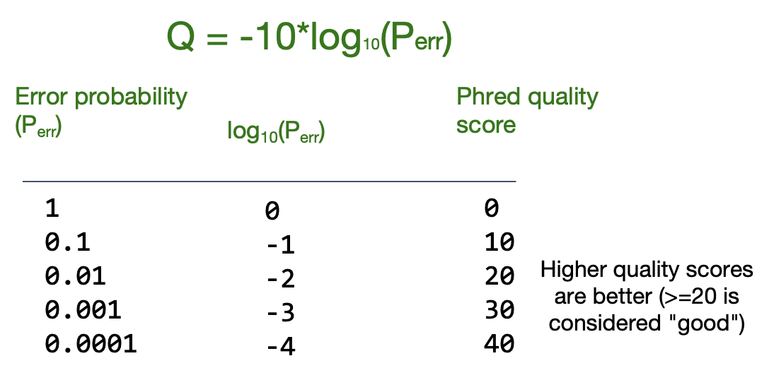
Phred quality score calculation
A quality score of 20 (Q20) represents an error rate of 1 in 100 (meaning every 100 bp sequencing read may contain an error), with a corresponding call accuracy of 99%.

Slide 36
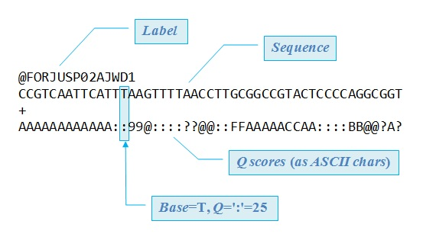
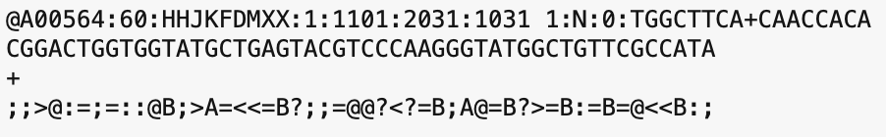
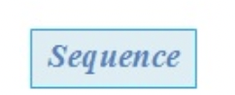
FASTQ files are text files with detailed information about each read.
Image adapted from Robert Edgar's web site https://www.drive5.com/

Slide 37
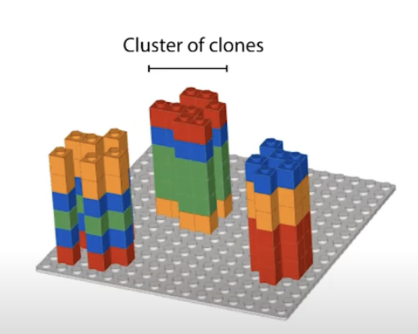
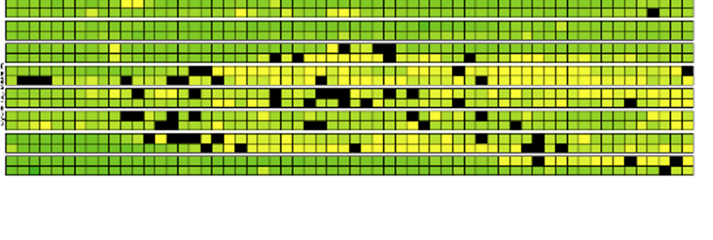


Base calling may not be accurate
Possible causes
Blocking of synthesis after one nucleotide addition may be inefficient.
Clusters might not be monoclonal.
A tile may be out of focus.
Oil, reagent, etc. on flow cell or imaging component, etc.
=> Need to record quality of each base call.
Notes:
https://www.youtube.com/watch?v=U4QnpciIJhM

Slide 38
Knowledge check - Poll 2
What is the flow cell id in the fastq file below?
@SIM:1:FCX:1:15:6329:1045 1:N:0:2
TCGCACTCAACGCCCTGCATA
+
<>;##=><9=AAAAAAAAA9#
15
FCX
#
SIM

Slide 39
Knowledge check - Poll 3
What is the Q-score (ASCII) of the 3rd base?
@SIM:1:FCX:1:15:6329:1045 1:N:0:2
TCGCACTCAACGCCCTGCATA
+
<>;##=><9=AAAAAAAAA9#
G
>
;
I
None of the above

Slide 40
FastQC: Quality check of sequencing data
Summarizes quality of base calls
Any sequences more frequently observed than expected?
Any sequence biases?
Any GC biases?
Checks for presence of known adapters
Notes:
For more: https://rtsf.natsci.msu.edu/genomics/tech-notes/fastqc-tutorial-and-faq/

Slide 41
Examples of FastQC reports
Good Illumina data: https://www.bioinformatics.babraham.ac.uk/projects/fastqc/good_sequence_short_fastqc.html
Bad Illumina data: https://www.bioinformatics.babraham.ac.uk/projects/fastqc/bad_sequence_fastqc.html

Slide 42
What if QC gives warn/fail flag?
Non-normal GC content per read?
Normal expected for whole-genome shotgun sequencing.
RNA-seq might give different distributions.
Non-uniform sequence content per nucleotide?
First 10-15 nt in RNA-seq often non-uniform.
High duplication levels or overrepresented sequences?
Are they contaminants, e,g. adapters or PCR duplicates?
If so, clean up contaminants.
Could be attributed to highly abundant transcripts.
Notes:
https://sequencing.qcfail.com/articles/positional-sequence-bias-in-random-primed-libraries/

Slide 43
RNA-seq - analysis workflow
Biological question
Library preparation
Sequencer: Reads Fastq
Quality check
FastQC
Session 1 Concepts:
Trimming
cutadapt
Quality check
FastQC
Demo
Alignment/Mapping
STAR
Quality check
Session 2 Concepts:
Counting Reads
featureCounts
Quality check
DGE
Notes:
Sequencing centers often provide reads in the FASTQ format. The raw reads contain sequences of adapters added during library preparation, which are trimmed to start with. Then, the reads are typically mapped to a reference genome sequence. Counts of reads mapping to genes are tallied and used for differential gene expression analysis. At all stages, it is important to perform quality control of the data. All the tools mentioned in the subsequent slides for these steps are available via docker or can be installed locally.
Please download and install Docker Desktop from: https://docs.docker.com/get-docker/
All UCSF/Gladstone affiliates can request access to Wynton. Visit https://wynton.ucsf.edu/hpc/about/join.html

Slide 44
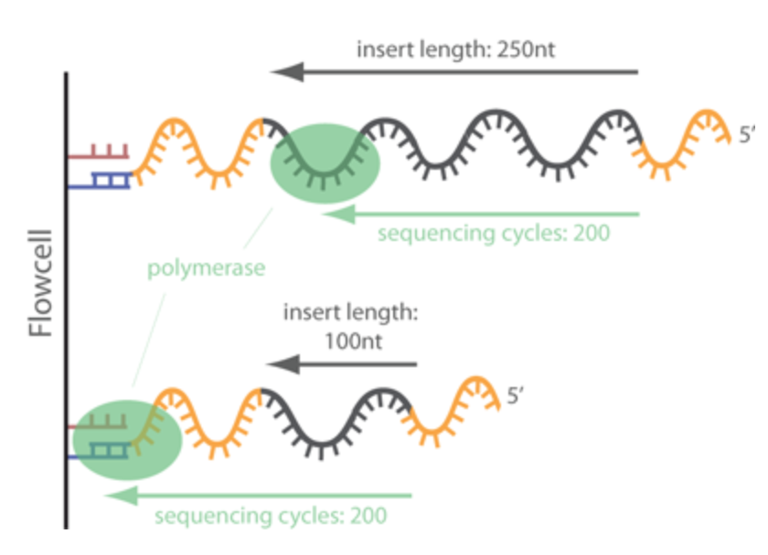
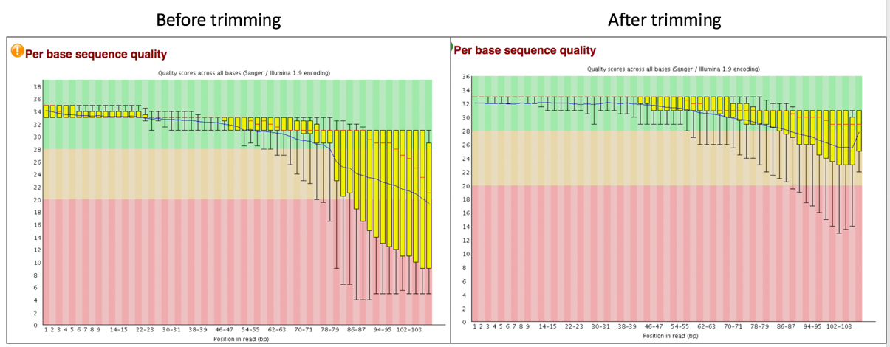
Trimming - Removing adapters
Tools: cutadapt, Trimmomatic
Notes:
https://www.ecseq.com/support/ngs/trimming-adapter-sequences-is-it-necessary

Slide 45
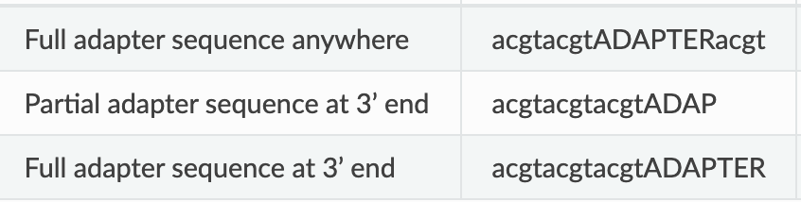
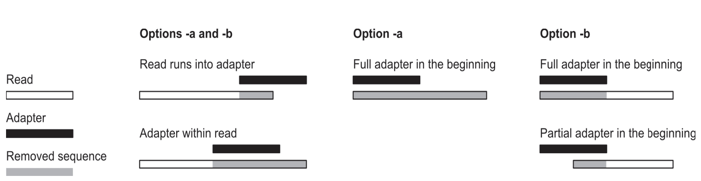
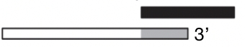
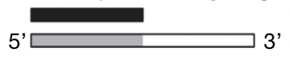
cutadapt removes adapters
Search for adapter sequence in read.
Allow for mismatches in sequence.
If significant alignment, cut.
5’
3’
5’
3’
5’
3’
5’
3’
Forward read ->
Set max error rate (default 1%)
Min overlap (default 3)
Aligned region
5’
3’
The actual error rate is computed as the number of errors in the match divided by the length of the matching part of the adapter.
<- Reverse read
Notes:
https://cutadapt.readthedocs.io/en/stable/guide.html

Slide 46
Poll 4
How are you feeling about the content covered so far?
Great - I am getting it
Okay - I am hanging in there
I am learning a lot
I need help

Slide 47
Break
Please drop a question in the chat or speak up

Slide 48
RNA-seq - analysis workflow
Biological question
Library preparation
Sequencer: Reads Fastq
Quality check
FastQC
Session 1 Concepts:
Trimming
cutadapt
Quality check
FastQC
Session 2 Demo
Alignment/Mapping
STAR
Quality check
Session 2 Concepts:
Counting Reads
featureCounts
Quality check
DGE brief overview
Notes:
Sequencing centers often provide reads in the FASTQ format. The raw reads contain sequences of adapters added during library preparation, which are trimmed to start with. Then, the reads are typically mapped to a reference genome sequence. Counts of reads mapping to genes are tallied and used for differential gene expression analysis. At all stages, it is important to perform quality control of the data. All the tools mentioned in the subsequent slides for these steps are available via docker or can be installed locally.
Please download and install Docker Desktop from: https://docs.docker.com/get-docker/
All UCSF/Gladstone affiliates can request access to Wynton. Visit https://wynton.ucsf.edu/hpc/about/join.html

Slide 49
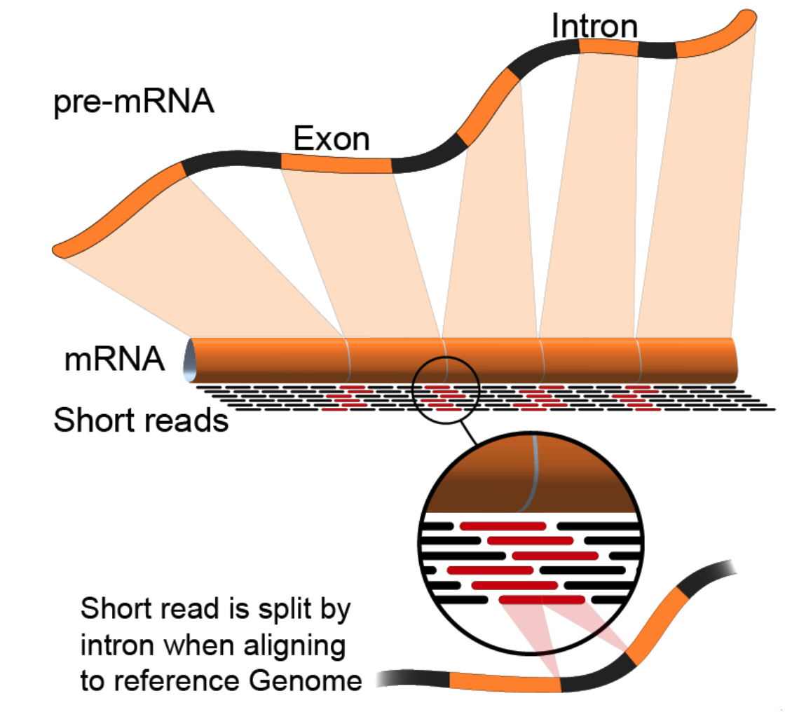
Alignment to genome : challenges
Reads from junctions: one part of it maps to one exon and the other half maps to the other exon
Reference sequences can be very long (~3 billion bp for humans).
Order of 100 million reads to be mapped.
Need to account for splicing.
Allow for PCR artifacts/sequencing errors.
Notes:
Suggested reading:
https://www.ncbi.nlm.nih.gov/pmc/articles/PMC3322381/pdf/nihms-366740.pdf
https://academic.oup.com/bioinformatics/article/29/1/15/272537
Video lectures on how these mapping tools work:
https://www.youtube.com/watch?v=hpb-mH-yjLc&list=PL2mpR0RYFQsBiCWVJSvVAO3OJ2t7DzoHA

Slide 50
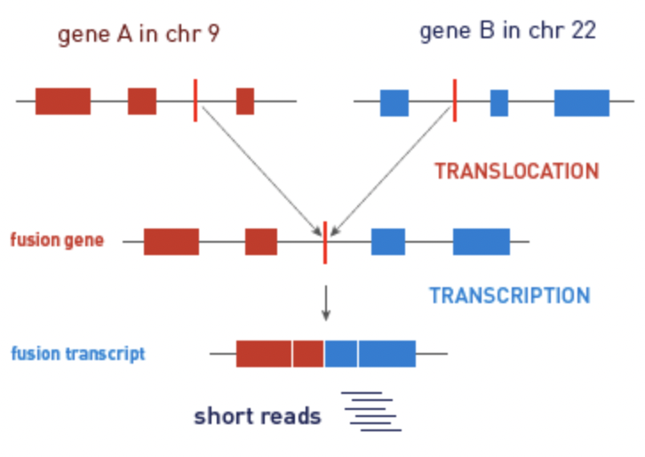
Alignment/Mapping: STAR tool
STAR (Spliced Transcripts Alignment to a Reference (STAR))
is popular for RNA-Seq data because it
does unbiased de novo detection of canonical junctions
can discover non-canonical splices
can discover chimeric (fusion) transcripts
Tools: STAR, HISAT2, TopHat2, bowtie2, salmon, kallisto

Slide 51
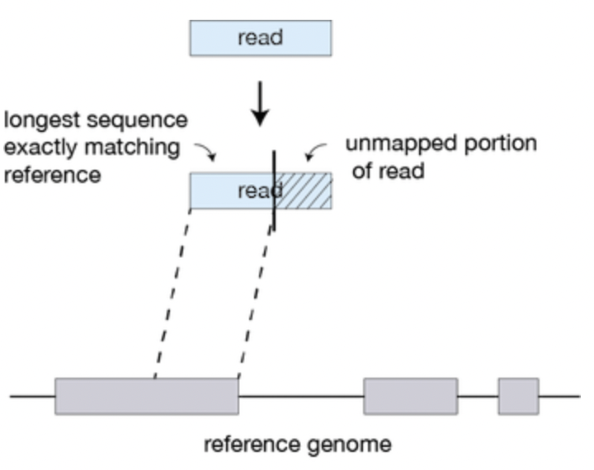
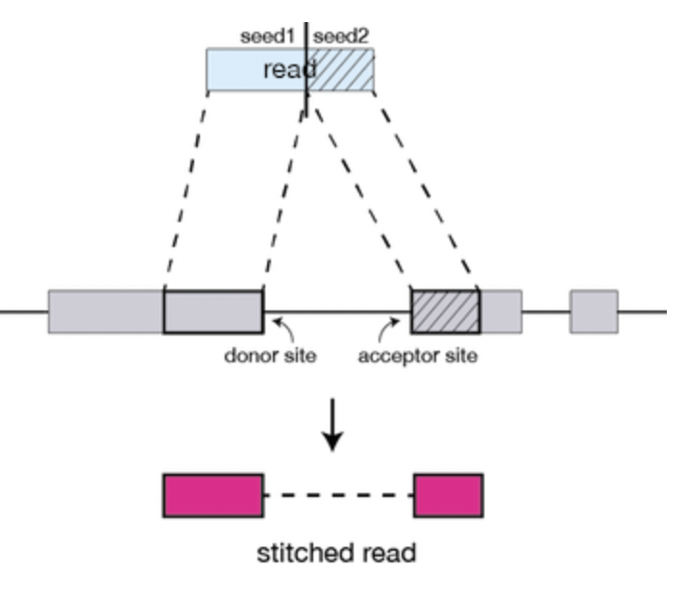
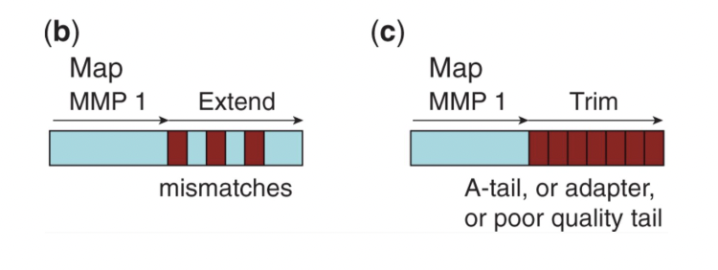
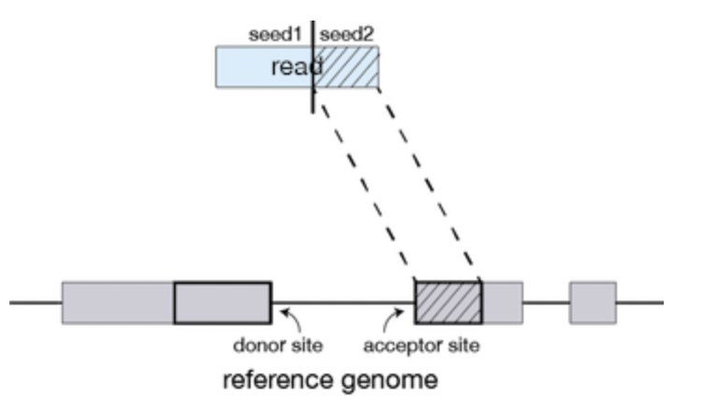
Alignment/Mapping: How does STAR work?
Step 1: Seed search
Step 2: Stitching and scoring
MMP1
MMP1
MMP = Maximum Mappable Prefix
Anchor seeds in a genomic region
Image source: https://hbctraining.github.io/Intro-to-rnaseq-hpc-O2/lessons/03_alignment.html
Notes:
https://www.ncbi.nlm.nih.gov/pmc/articles/PMC3530905/

Slide 52
Alignment/Mapping: Inputs needed
Reads to align
FASTQ file after cleaning (trimming adapters).
Reference sequence to align to
Example – “rDNA_sequence.fasta”
FASTA format. Two lines per sequence.
Starting with “>”, followed by sequence name/identifier.
Sequence.
File extensions: .fasta, .fa, .txt.
Examples of acceptable genome sequence files for STAR:
ENSEMBL: files marked with .dna.primary.assembly
GENCODE: files marked with PRI (primary). Strongly recommended for mouse and human.
Notes:
Examples of acceptable genome sequence files:
ENSEMBL: files marked with .dna.primary.assembly, such as: ftp://ftp.ensembl. org/pub/release-77/fasta/homo_sapiens/dna/Homo_sapiens.GRCh38.dna.primary_ assembly.fa.gz
GENCODE: files marked with PRI (primary). Strongly recommended for mouse and human: http://www.gencodegenes.org/.

Slide 53
Understanding STAR output
1. Alignments in SAM format
2. Summary of mapping statistics
How many reads mapped?
How many unmapped?
...

Slide 54
Sequence Alignment/Map (SAM) format
Open with Excel.
First few lines contain metadata about alignments.
These lines start with “@”.
Example – version of file format, sorting order of alignments, grouping, etc.
After header, a table of alignments of each read to the genome.
Alignment reports often very large files.
Binary Alignment/Map (BAM) extension used for compressed SAM files.
Indexed BAM -> BAI
Notes:
Suggested reading:
https://samtools.github.io/hts-specs/SAMv1.pdf

Slide 55
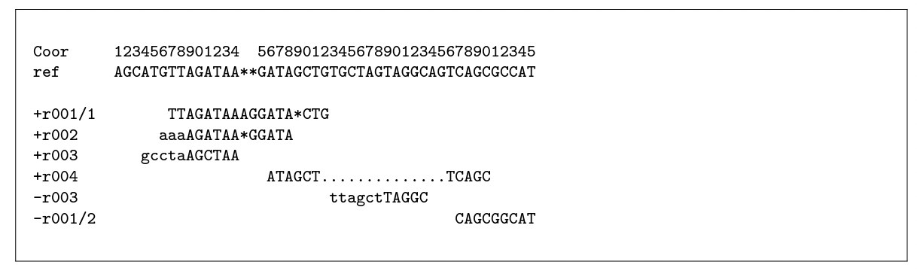
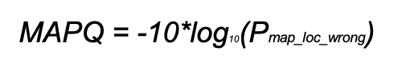
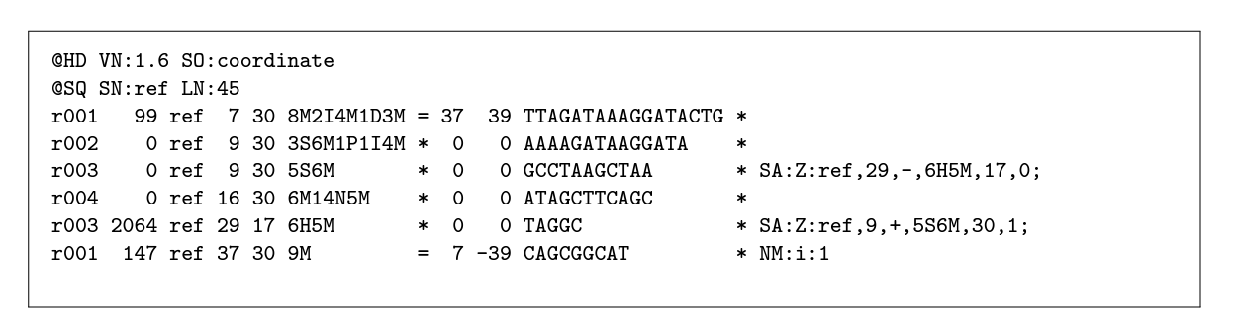
From the alignment to SAM format
Alignment
SAM
Notes:
chrome-extension://efaidnbmnnnibpcajpcglclefindmkaj/https://samtools.github.io/hts-specs/SAMv1.pdf

Slide 56
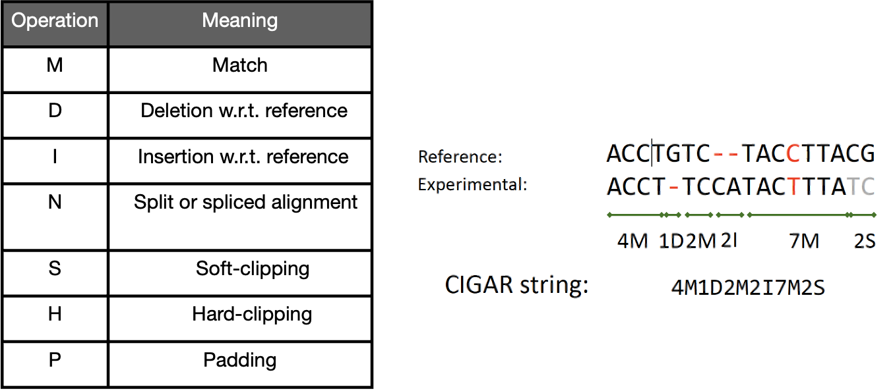
The CIGAR string: encode the details of
the alignment

Slide 57
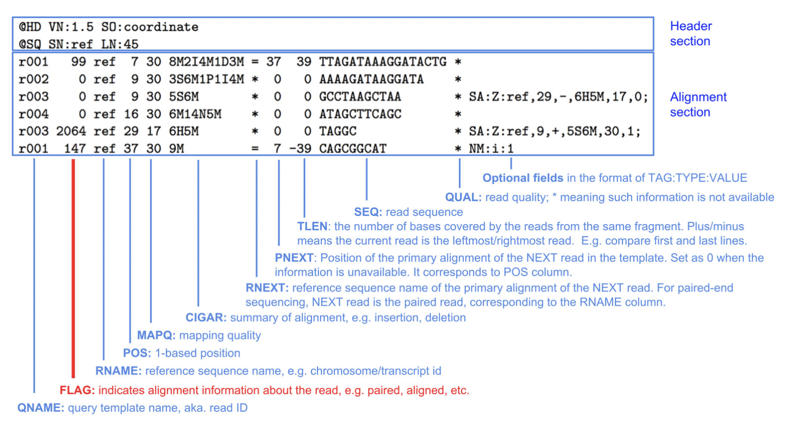
SAM format

Slide 58
Alternative tools
Many. Example – HISAT2, TopHat2, bowtie2, salmon, kallisto, etc.
Differences in speed and memory requirement.
Pros and cons of each:
Example: Some handle spliced alignment, others do not.
…
Comparison across tools
Notes:
Suggested reading:
https://www.ncbi.nlm.nih.gov/pmc/articles/PMC3322381/pdf/nihms-366740.pdf

Slide 59
Pseudo-aligners
Much, much faster
Less memory intensive than STAR
They are called "pseudo" aligners because they do not perform the full alignment of each sequencing read to a reference genome or transcriptome.
Pseudoaligners use a reference transcriptome to create a set of potential transcript sequences or exonic regions, respectively. Then, they map the reads to these sequences without attempting to align each read to its exact position in the reference.
Examples of tools: Salmon, Kallisto
Notes:
Kallisto: https://www.nature.com/articles/nbt.3519
Salmon: https://www.ncbi.nlm.nih.gov/pmc/articles/PMC5600148/

Slide 60
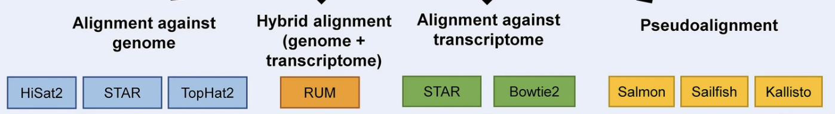
Alignment tool summary
Adapted from https://www.nature.com/articles/s41598-020-76881-x/figures/1
Notes:
https://www.nature.com/articles/s41598-020-76881-x/figures/1
https://bowtie-bio.sourceforge.net/bowtie2/index.shtml#:~:text=Bowtie%202%20is%20an%20ultrafast,long%20(e.g.%20mammalian)%20genomes.
Comparative Analysis of RNA-Seq Alignment Algorithms and the RNA-Seq Unified Mapper (RUM) Gregory R. Grant, Michael H. Farkas, Angel Pizarro, Nicholas Lahens, Jonathan Schug, Brian Brunk, Christian J. Stoeckert Jr, John B. Hogenesch and Eric A. Pierce.

Slide 61
RNA-seq - analysis workflow
Biological question
Library preparation
Sequencer: Reads Fastq
Quality check
FastQC
Session 1 Concepts:
Trimming
cutadapt
Quality check
FastQC
Demo
Alignment/Mapping
STAR
Quality check
Session 2 Concepts:
Counting Reads
featureCounts
Quality check
DGE
Notes:
Sequencing centers often provide reads in the FASTQ format. The raw reads contain sequences of adapters added during library preparation, which are trimmed to start with. Then, the reads are typically mapped to a reference genome sequence. Counts of reads mapping to genes are tallied and used for differential gene expression analysis. At all stages, it is important to perform quality control of the data. All the tools mentioned in the subsequent slides for these steps are available via docker or can be installed locally.
Please download and install Docker Desktop from: https://docs.docker.com/get-docker/
All UCSF/Gladstone affiliates can request access to Wynton. Visit https://wynton.ucsf.edu/hpc/about/join.html

Slide 62
Bioinformatics software ecosystem
Tools that “do one thing, and do it well”.
Tools for this workshop: fastqc, cutadapt, STAR, featureCounts
Available via docker hub
Some are pre-installed on Wynton; others we can install ourselves
Download a container with all tools installed; use anywhere
Everything can be installed on a laptop
Notes:
Login to a Wynton dev node and search for the tools using module spider

Slide 63
Different platforms for computing
Web-based platforms
Graphical User Interface
Command Line Interface
etc..

Slide 64
Galaxy: Open source, web-based platform that integrates many tools.
Free, public, internet accessible resource.
https://usegalaxy.org/
Data transfer and data storage are not encrypted.
DO NOT UPLOAD PROTECTED DATA!!!
Notes:
Galaxy provides a collection of tools to analyze variety of biomedical data
https://usegalaxy.org/

Slide 65
Command line interfaces allow scripting
Graphical User Interface
Consists of windows, icons, menus, pointers
Not always available for bioinformatics
Command Line Interface
Text based
Allow automation by scripting
Examples
Wynton CLI
MacOS: Terminal
Windows: Command Prompt, PuTTY

Slide 66
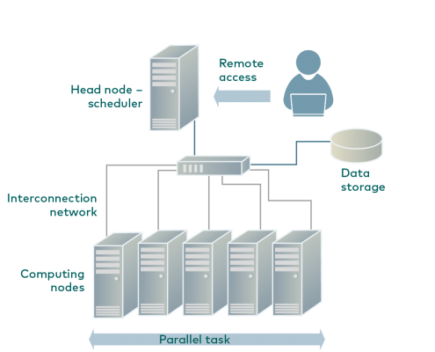
Wynton is a high-performance computing (HPC) system for UCSF affiliates
How to access Wynton? Visit:
https://wynton.ucsf.edu/hpc/get-started/access-cluster.html
Most universities/ institutions doing data-intensive science have HPC cluster on campus.
(see Description for image source)
Notes:
Image taken from https://hpc.rtu.lv/introduction-to-hpc/?lang=en

Slide 67
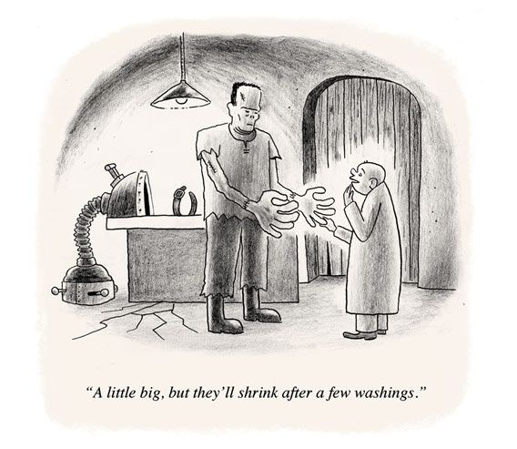
Containers enable reproducibility
Tools are constantly under development
=> Many versions around
Dependencies complicate installations
Dependencies are also constantly under development
=> Many versions around
Different labs use different programming languages

Slide 68
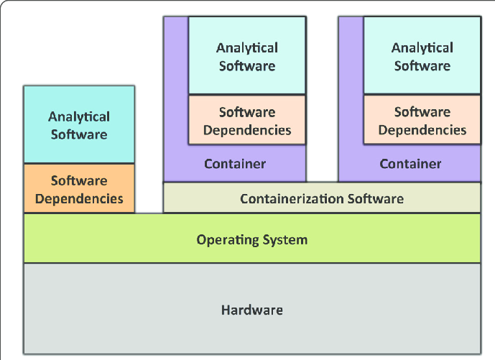
A container is like a computer within a computer
Containerization software examples:
Singularity
Docker (has security issues in the context of HPC)
Containers can be deployed on commercial cloud computing platforms, e.g., Amazon Web Services
(see Description for image source)
Notes:
Image source: https://gigascience.biomedcentral.com/track/pdf/10.1186/s13742-016-0135-4
Paper introducing Singularity: https://journals.plos.org/plosone/article/file?id=10.1371/journal.pone.0177459&type=printable
https://phoenixnap.com/kb/docker-image-vs-container

Slide 69
Best to use singularity with Linux (currently)
Limited support for MacOS
Even more limited support for Microsoft Windows

Slide 70
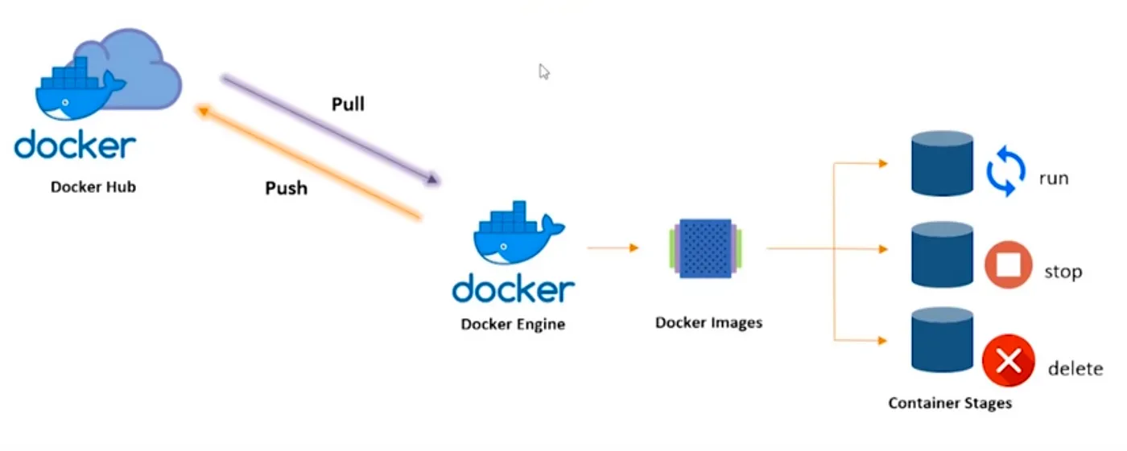
Docker Container Lifecycle
Image source: https://pradeep-sg406.medium.com/introduction-to-docker-5212421782df

Slide 71
Poll 5
Which operating system will you use for the hands-on section?
Mac - Intel chip
Mac - Apple chip
Windows
Linux

Slide 72
Docker desktop download and installation (https://www.docker.com/products/docker-desktop/ )
(https://docs.docker.com/desktop/install/windows-install/ )
How to access public datasets?
Downloading data from GEO
https://bioinformaticsworkbook.org/dataAcquisition/fileTransfer/sra.html#gsc.tab=0
https://erilu.github.io/python-fastq-downloader/

Slide 73
Session 1: Take-home messages
Define your hypothesis and datasets before planning RNA-seq experiment
Each steps of the analysis can be affected by some kind of bias - Check the quality after each step!
Be familiar with file formats
Tomorrow:
Start with summarizing the steps so far
Understand the alignment output
Feature counts
Demo step by step
If you are not able to attend tomorrow, please take the survey:
https://www.surveymonkey.com/r/F75J6VZ

Slide 74
Upcoming workshop at Gladstone:
Introduction to Linear Mixed Effects Models
September 29–30
Working on Wynton
October 2–3
Intermediate RNA-Seq Analysis Using R
October 6
Introduction to Pathway Analysis
October 16
Statistics of Enrichment Analysis Methods
October 20–21
Single Cell RNA-Seq Analysis
October 27–28

Slide 75
Introduction to RNA-seq data analysis
Michela Traglia, Ayushi Agrawal
Bioinformatics Core, GIDB
September 22-23, 2025

Slide 76
Working material for this workshop
Single_read.fastq
Bacteria_GATTACA_L001_R1_001.fastq
Adapter_Sequence.fasta
rDNA_sequence.fasta
rDNA.gtf
all_steps_docker_desktop_mac.sh
all_steps_docker_desktop_windows.sh
Slides
Please install Docker https://docs.docker.com/get-docker/

Slide 77
Workshop outline
Session 1
RNA-seq experiments and protocols overview
Understanding the sequencer output
From sequencer output to FastQC
From FastaQC to Trimming
Mapping to reference genome
Break
Introduction to docker and setup
Session 2 (day2)
Summarize steps so far
From alignment to counting features
Break
Demo
Additional resources

Slide 78
Session 2
Tools: Docker, FastaQC, cutadapt, STAR, featureCounts

Slide 79
RNA-seq - summary
Single_read.fastq
Bacteria_GATTACA_L001_R1_001.fastq

Slide 80

Bioinformatic pipeline - summary
FASTQ format
FASTQ file
FastQC - bad experiment needs trimming - cutadapt
FastQC - good experiment

Slide 81

Bioinformatic pipeline - summary
Alignment and pseudo-alignment tools
How STAR works

Slide 82
Knowledge check
Which information do you find in a SAM/BAM file?
Sequences, like a FASTQ file
Location of the read on the chromosome
Mapping quality
All of the above

Slide 83


featureCounts
Input:
Alignment BAM file
Annotation SAF/GFF/GTF file
SAF
meta-feature is the aggregation of a set of features with the same gene_id

Slide 84


How many reads overlap annotated regions?
Use featureCounts
Narrow down the genomic region that could contain features overlapping with the query read
Hierarchical data structure - features within blocks within bins
Notes:
Suggested reading:
https://academic.oup.com/bioinformatics/article/30/7/923/232889

Slide 85


Estimation of the strandness - directionality of the RNA molecule
In a stranded forward library, reads map mostly on the genes located on forward strand (here gene1).
With stranded reverse library, reads map mostly on genes on the reverse strand (here gene2).
With unstranded library, reads maps on genes on both strands.
Image source: https://training.galaxyproject.org/training-material/
Notes:
Suggested reading:
https://www.ncbi.nlm.nih.gov/pmc/articles/PMC3005310/
https://blog.genewiz.com/stranded-vs-non-stranded-rna-seq

Slide 86

featureCounts output
count matrix (text file)
a summary file

Slide 87
Gene-wise counts should be normalized before comparing between samples
Library size: counts can differ because of different library sizes (Sample A and Sample B)
Real change in expression level of a gene vs non-biological reasons
Need to estimate variability (dispersion)
Several steps and specific tools
Intermediate RNA-seq workshop
May 19, 1-4p

Slide 88
RNA-seq - analysis workflow
Biological question
Library preparation
Sequencer: Reads Fastq
Quality check
FastQC
Session 1 Concepts:
Trimming
cutadapt
Quality check
FastQC
Session 2 Demo
Alignment/Mapping
STAR
Quality check
Session 2 Concepts:
Counting Reads
featureCounts
Quality check
DGE brief overview
Notes:
Sequencing centers often provide reads in the FASTQ format. The raw reads contain sequences of adapters added during library preparation, which are trimmed to start with. Then, the reads are typically mapped to a reference genome sequence. Counts of reads mapping to genes are tallied and used for differential gene expression analysis. At all stages, it is important to perform quality control of the data. All the tools mentioned in the subsequent slides for these steps are available via docker or can be installed locally.
Please download and install Docker Desktop from: https://docs.docker.com/get-docker/
All UCSF/Gladstone affiliates can request access to Wynton. Visit https://wynton.ucsf.edu/hpc/about/join.html

Slide 89
Typical command line syntax of bioinformatics tools
$ Toolname –a 10 –b file.txt –c xyz.fq –o pqrs.tuv
$ Toolname --paramA 10 –b file.txt –c xyz.fq –outFile pqrs.tuv
Examples:
$ fastqc –t 16 –o ./ Bacteria_GATTACA_L001_R1_001.fastq
$ fastqc *.fastq
$ cutadapt –a GATTACA –o ./trimmed.fastq input.fastq

Slide 90
Examples of commands to execute various steps
Trimming adapters
$ cutadapt \
> –a file:Adapter_Sequence.fasta \
> –o ./trimmed.fastq Bacteria_GATTACA_L001_R1_001.fastq
Similarly for other tools

Slide 91
Typical command line syntax with singularity container
$ singularity exec containername Toolname –a 10 –b file.txt –c xyz.fq –o pqrs.tuv
Examples:
$ singularity exec rna_seq_container.sif fastqc –t 16 –o ./ Bacteria_GATTACA_L001_R1_001.fastq

Slide 92

File paths := Location of file on computer
Lots of files on a computer
Organized in directories which may contain sub-directories
Bioinformatics tools may need file inputs and may output files
Where are the input files located on the computer?
Searching entire computer not practical
What if multiple files have the same name?
Where should the output files be saved?
Notes:
Command line cheat sheet
https://www.git-tower.com/blog/command-line-cheat-sheet/

Slide 93
File paths
./ is for current working directory
../ is for parent directory of current working directory
../../ is for parent directory of parent directory of current working directory
/Root/DirA/DirC/File4 is the path of File4 in the image to the right.

Slide 94
RNA-seq - analysis workflow
Biological question
Library preparation
Sequencer: Reads Fastq
Quality check
FastQC
Session 1 Concepts:
Trimming
cutadapt
Quality check
FastQC
Demo
Alignment/Mapping
STAR
Quality check
Session 2 Concepts:
Counting Reads
featureCounts
Quality check
DGE brief overview
Notes:
Sequencing centers often provide reads in the FASTQ format. The raw reads contain sequences of adapters added during library preparation, which are trimmed to start with. Then, the reads are typically mapped to a reference genome sequence. Counts of reads mapping to genes are tallied and used for differential gene expression analysis. At all stages, it is important to perform quality control of the data. All the tools mentioned in the subsequent slides for these steps are available via docker or can be installed locally.
Please download and install Docker Desktop from: https://docs.docker.com/get-docker/
All UCSF/Gladstone affiliates can request access to Wynton. Visit https://wynton.ucsf.edu/hpc/about/join.html

Slide 95
Dataset
Small dataset with 100k reads (for practice only).
FASTQ to tallying counts.
Analysis of real datasets can take time. Real sequenced read libraries can be found online https://www.ncbi.nlm.nih.gov/sra/.
The practice dataset has a low number of reads, which is not meaningful for differential gene expression analysis. Hence, for differential gene expression analysis use a real counts matrix, an example of which can be found at https://www.ncbi.nlm.nih.gov/geo/query/acc.cgi?acc=GSE49712.

Slide 96
Demo
Start Docker Desktop
Uploading FASTQ files to Docker container
Running FASTQC
Checking the adapter content
Notes:
For Docker and Wynton, the script is available in the workshop materials.
#Tutorial to login to wynton: https://wynton.ucsf.edu/hpc/get-started/access-cluster.html
#Tutorial for wynton development nodes: https://wynton.ucsf.edu/hpc/get-started/development-prototyping.html
#file transfer tutorial: : https://wynton.ucsf.edu/hpc/transfers/files-and-directories.html

Slide 97
Knowledge check - Poll 6
What is the sequence length reported by the FASTQC?
100000
50
0

Slide 98
Redo QC to ensure satisfactory quality
Run FastQC.
Is the adapter content gone?

Slide 99
Demo using Docker
Run STAR to align the reads to the reference genome

Slide 100
Break (5 min)
Need help? Please drop a question in the chat or speak up
Please take the survey:
https://www.surveymonkey.com/r/F75J6VZ

Slide 101
RNA-seq - analysis workflow
Biological question
Library preparation
Sequencer: Reads Fastq
Quality check
FastQC
Session 1 Concepts:
Trimming
cutadapt
Quality check
FastQC
Session 2 Demo
Alignment/Mapping
STAR
Quality check
Session 2 Concepts:
Counting Reads
featureCounts
Quality check
DGE brief overview
Notes:
Sequencing centers often provide reads in the FASTQ format. The raw reads contain sequences of adapters added during library preparation, which are trimmed to start with. Then, the reads are typically mapped to a reference genome sequence. Counts of reads mapping to genes are tallied and used for differential gene expression analysis. At all stages, it is important to perform quality control of the data. All the tools mentioned in the subsequent slides for these steps are available via docker or can be installed locally.
Please download and install Docker Desktop from: https://docs.docker.com/get-docker/
All UCSF/Gladstone affiliates can request access to Wynton. Visit https://wynton.ucsf.edu/hpc/about/join.html

Slide 102
Poll 7
How is the pace?
Too fast - please go slower
Just right - keep going at the same pace
Too slow - please go faster

Slide 103
Demo using Docker
Inspect the STAR output
How do the output files look?

Slide 104
Tools to manipulate files are available
Need to sort alignment report?
samtools
Need to convert FASTQ to FASTA?
fastx-toolkit
…
Google!

Slide 105
Demo using Docker
Run featureCounts to tally counts

Slide 106
RNA-seq - analysis workflow
Biological question
Library preparation
Sequencer: Reads Fastq
Quality check
FastQC
Trimming
cutadapt
Quality check
FastQC
Alignment/Mapping
STAR
Quality check
Counting Reads
featureCounts
Quality check
DGE
Notes:
Sequencing centers often provide reads in the FASTQ format. The raw reads contain sequences of adapters added during library preparation, which are trimmed to start with. Then, the reads are typically mapped to a reference genome sequence. Counts of reads mapping to genes are tallied and used for differential gene expression analysis. At all stages, it is important to perform quality control of the data. All the tools mentioned in the subsequent slides for these steps are available via docker or can be installed locally.
Please download and install Docker Desktop from: https://docs.docker.com/get-docker/
All UCSF/Gladstone affiliates can request access to Wynton. Visit https://wynton.ucsf.edu/hpc/about/join.html

Slide 107
Session 2 - Take-home messages
Each steps of the analysis can be affected by some kind of bias - Check the quality after each step!
Be aware of possible batch effects, non biological variability.
Know the tools and how they work. Use best practices for the analysis.
This workshop covered:
Common tools, e.g., fastqc, cutadapt, STAR
Common file formats, e.g., FASTQ, FASTA, SAM, GTF, BAM
Analysis on your computer using docker and on Wynton using singularity

Slide 108
Real data is complex
This workshop provides an introduction to typical RNA-seq analysis steps using an artificial dataset. Real data might need additional analyses choices.
Possible challenges with real data: (What we did not cover today)
What to do you if only 50%of reads align to reference?
What to do if FastQC reports unusual GC content?
What to do if the reference genome is incomplete?
How to deal with more complicated experimental designs?
How many replicates to use for RNA-seq?
Some analysis choices need experience. Consult with the Gladstone Bioinformatics core for such scenarios and data.
Notes:
E.g: The argument choices available for STAR

Slide 109
How to publish your code?
Tailored Training Sessions on Publishing Your Code with GitHub
Maximize the impact of your research by mastering GitHub with Gladstone's Bioinformatics Core training. The team of experts will help you easily share your code, collaborate with colleagues, publish a function or library, build a website, and more. The core can tailor a training session to meet your lab’s specific needs and bring your research to the next level. Reach out to the core to learn more or set up a training session.
Notes:
https://www.git-tower.com/blog/command-line-cheat-sheet/

Slide 110
Helpful resources
Wynton slack channel
ucsf-wynton.slack.com
Gladstone Bioinformatics Core slack channel
https://gladstoneinstitutes.slack.com/archives/C0145F1L7QS
Wynton tutorials
https://github.com/ucsf-wynton/tutorials/wiki

Slide 111
Helpful resources
Bacterial reference genome:
https://bacteria.ensembl.org/index.html
STAR and HISAT2 are more commonly used for eukaryotic RNA-seq. For bacterial RNA-seq data, Bowtie2 and BWA can be used as these are non-spliced reads. STAR can also be used for bacterial RNA-seq data but there some additional STAR options that should be specified when doing so.
How to add reporter sequence to the reference:
https://groups.google.com/g/rna-star/c/FGQRotrCB1Q
Cutadapt possible adapters types:
https://cutadapt.readthedocs.io/en/stable/guide.html#adapter-types

Slide 112
When I need help, which I do need on a daily basis,
I visit:
Slack channel for Wynton users
ucsf-wynton.slack.com
http://seqanswers.com/forums/
https://www.biostars.org/
https://www.rna-seqblog.com/
https://stackexchange.com/
Google groups for specific tools
GitHub issues
…

Slide 113
Thank you!
Please take the survey:
https://www.surveymonkey.com/r/F75J6VZ
Other resources
RNA-seq and analysis
RNA-seq review
RNA-seqlopedia
Galaxy tutorial

Slide 114
Upcoming workshop at Gladstone:
Introduction to Linear Mixed Effects Models
September 29–30
Working on Wynton
October 2–3
Intermediate RNA-Seq Analysis Using R
October 6
Introduction to Pathway Analysis
October 16
Statistics of Enrichment Analysis Methods
October 20–21
Single Cell RNA-Seq Analysis
October 27–28

